Slide 1

Classification of EEG Signals for Predicting Epileptic Seizures
Alba Asllanaj, Mostafa Shuva
University of Michigan – Dearborn
July 29, 2018

Slide 2
Agenda
Introduction
Experimental Evaluation
Algorithms
Naive Bayes’
Logistic Regression & Elastic Net
Support Vector Machine
Pre-processing Methods
Fast Fourier Transform (FFT)
Empirical Mode Decomposition (EMD)
Continuous Wavelet Transform (CWT)
Results and Analysis
Experiment 1 - FFT
Experiment 2 - EMD
Experiment 3 - CWT
Future Works
Conclusion

Slide 3
Introduction
Purpose: To predict and classify whether a patient is having an epileptic seizure based on given data
Execution: Use pattern recognition methods based on ECE 5831 studies
Dataset used: UCI
4097 data points that were recorded from 500 individuals
Data collected in the time span of 23.5 seconds
sampled at 173.61 Hz
each second contains 178 data points
response variable y is the output of the input vector containing 178 data points for one second
Three major algorithms and three pre-processing methods used

Slide 4
Experimental Evaluation - Algorithms
Naive Bayes’
Simple
Fast
Benchmark
Logistic Regression & Elastic Net
Applies L1 & L2 regularization techniques
Exploits sparsity of the frequency spectrum of EEG data
Support Vector Machine
Complex
Requires hyperparameter tuning
Computationally expensive

Slide 5
Experimental Evaluation - Preprocessing Methods
Fast Fourier Transform
Compute the frequency spectrum of the EEG data
Empirical Mode Decomposition
Extract the intrinsic mode functions of the EEG data
Wavelet transform
Compute the wavelet filter bank for the EEG data

Slide 6
Results & Analysis - Performance Metrics
Test and Train Error - accuracy measurement
Sensitivity - the percentage of positive classifications out of patients that had seizures
Specificity - the percentage of negative classifications out of patients that didn’t have seizures
Precision - the percentage of positive classifications classified correctly
Fall out - this is the inverse of specificity
Runtime - how long it took the algorithm to run

Slide 7
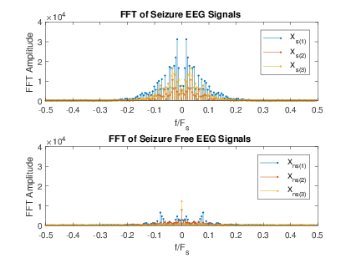
Results & Analysis - Experiment 1
Fast Fourier Transform (FFT)
Comparison of the Fourier transform of the first 3 sample seizure and seizure free EEG signals
The same axes were used to provide an easy visual comparison of the difference between FFT amplitudes
The spectrum seems to be relatively sparse

Slide 8
Results & Analysis - Experiment 1
Computed the FFT of each of EEG sample
SVM proved to be most accurate with the shortest runtime (tuned algorithm)
Naive Bayes had similar performance
Logistic Regression had the worst performance
Lower accuracy with L2 regularization
Longest runtime when using Elastic Net classifier
Preprocessing: Fast Fourier Transform |  | Based on Test Set
Algorithm | Training Error | Test Error | Sensitivity Score | Specificity Score | Precision | Fall Out | F1 Score | Runtime
Naive Bayes' | 0.0231 | 0.0304 | 0.9815 | 0.9589 | 0.9551 | 0.0411 | 0.9681 | 0.685
Logistic Regression w/ alpha = 0.5 (L2) | 0.4927 | 0.5293 | 1 | 0 | 0.4707 | 1 | 0.6401 | 1.049
Elastic Net w/ alpha = 0.5 (L1) | 0.0111 | 0.0163 | 1 | 0.9692 | 0.9695 | 0.0308 | 0.983 | 2.546
Elastic Net w/ varying alpha we find alpha = 0.01 (L1) | 0.0079 | 0.0098 | 1 | 0.9815 | 0.9796 | 0.0185 | 0.9897 | 8.396
SVM w/ C = 1, gamma = 1, rbf kernel | 0 | 0.5293 | 1 | 0 | 0.4707 | 1 | 0.6401 | 1.832
SVM optimal search with C=0.001, gamma = 109.9486, linear kernel | 0.0014 | 0.0043 | 0.9954 | 0.9959 | 0.9954 | 0.0041 | 0.9954 | 0.675

Slide 9
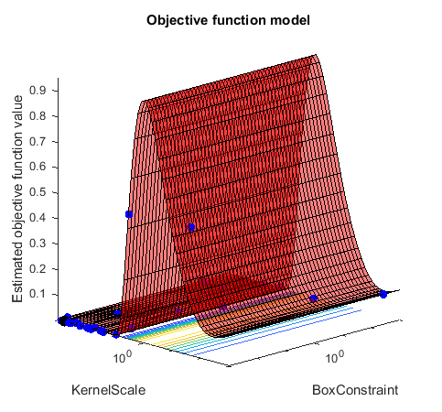
Results & Analysis - Experiment 1
SVM Sample

Slide 10
Results & Analysis - Experiment 2
Empirical Mode Decomposition (EMD)
Used to decompose and simplify complicated signals into a finite number of intrinsic mode functions required to perform signal analysis
Inputs to the classifiers:
Signal decomposed into intrinsic mode functions
Returned as a matrix table
Sum of highest and lowest mode functions

Slide 11
Results & Analysis - Experiment 2
In comparison to Experiment 1 EMD does not provide a sparse representation of the EEG data
The logistic regression & elastic net’s performance is degraded
Naive Bayes’ and SVM (once its parameters are tuned) perform exceptionally well compared to Logistic Regression
Preprocessing: Empirical Mode Decomposition |  | Based on Test Set
Algorithm | Training Error | Test Error | Sensitivity Score | Specificity Score | Precision | Fall Out | F1 Score | Runtime
Naive Bayes' | 0.0144 | 0.0207 | 0.9931 | 0.9671 | 0.9641 | 0.0329 | 0.9784 | 0.533
Logistic Regression w/ alpha = 0.5 (L2) | 0.5361 | 0.5272 | 0.5242 | 0.4271 | 0.4486 | 0.5729 | 0.4835 | 0.623
Elastic Net w/ alpha = 0.5 (L1) | 0.2804 | 0.2902 | 0.9746 | 0.4743 | 0.6224 | 0.5257 | 0.7597 | 1.043
Elastic Net w/ varying alpha we find alpha = 0.01 (L1) | 0.2804 | 0.2902 | 0.9746 | 0.4743 | 0.6224 | 0.5257 | 0.7597 | 1.043
SVM w/ C = 1, gamma = 1, rbf kernel | 0 | 0.5293 | 1 | 0 | 0.4707 | 1 | 0.6401 | 1.864
SVM optimal search w/ C=155.7453, gamma = 317.992, linear kernel | 0 | 0.038 | 0.9307 | 0.9897 | 0.9877 | 0.0103 | 0.9584 | 1.212

Slide 12
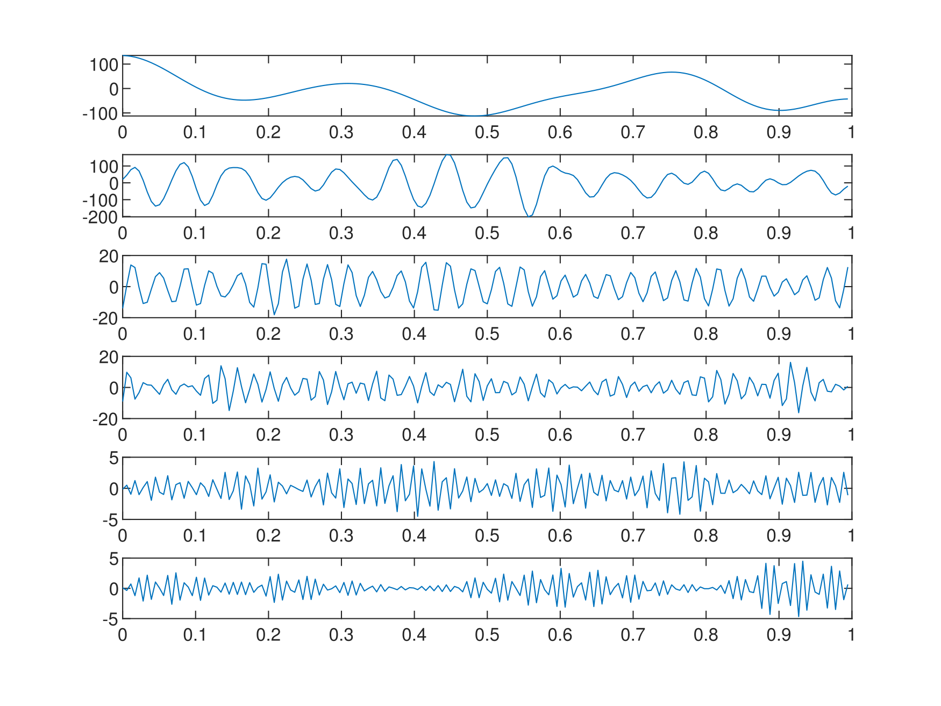
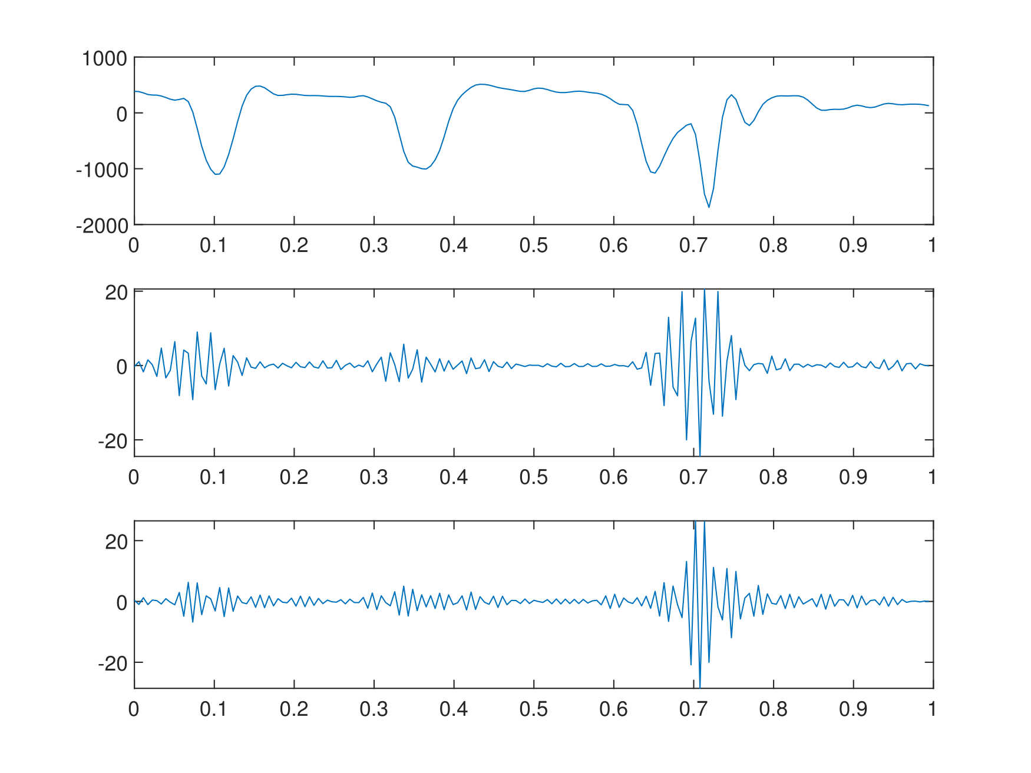
Results & Analysis - Experiment 3
Wavelet Transform
Localized in time and frequency
Able to determine what frequencies are present, where, and at what scale
CWT was used as the pre-processing method
EWT Decomposition of Interictal EEG
EWT Decomposition of Ictal EEG

Slide 13
Results & Analysis - Experiment 3
Performance similar to Experiment 1
Naive Bayes (6.52%) and SVM (6.85%) test error
Logistic regression classifier (with L2 regularization), and untuned SVM classifier perform the worst in accuracy
L1 regularization with elastic net classifier shows immediate performance increase
CWT behaves similarly to the FFT where it decomposes the EEG signal into its’ frequency representation
Preprocessing: Wavelet Transform |  | Based on Test Set
Algorithm | Training Error | Test Error | Sensitivity Score | Specificity Score | Precision | Fall Out | F1 Score | Runtime
Naive Bayes' | 0.075 | 0.0652 | 0.9792 | 0.8953 | 0.8926 | 0.1047 | 0.9339 | 0.536
Logistic Regression w/ alpha = 0.5 (L2) | 0.4927 | 0.5293 | 1 | 0 | 0.4707 | 1 | 0.6401 | 0.635
Elastic Net w/ alpha = 0.5 (L1) | 0.0739 | 0.0685 | 0.9769 | 0.8912 | 0.8887 | 0.1088 | 0.9307 | 7.11
Elastic Net w/ varying alpha we find alpha = 0.01 (L1) | 0.0712 | 0.0625 | 0.9746 | 0.8994 | 0.896 | 0.1006 | 0.9336 | 6.897
SVM w/ C = 1, gamma = 1, rbf kernel | 0 | 0.5293 | 1 | 0 | 0.4707 | 0 | 0.6401 | 2.245
SVM optimal search w/ C=0.001, gamma = 6.2014, linear kernel | 0.0666 | 0.0685 | 0.963 | 0.9035 | 0.8987 | 0.0963 | 0.9298 | 0.761

Slide 14
Conclusion
The overall goal for this project is to develop an algorithm SVM, Naive Bayes, and logistic regression as classifiers to determine whether a patient will have a seizure based on the EEG data
We found that:
Naive Bayes’ performs well for being a simple algorithm
SVM classifiers perform best when hyperparameters are tuned
Logistic regression is an excellent choice of classifier for this problem if L1 regularization is used
Future work:
Better pre-processing techniques
Neural Networks & Multilayer Perceptrons

